Slide 1
Distribuição T-student com parâmetros de locação e escala
Daniel Krügel

Slide 2
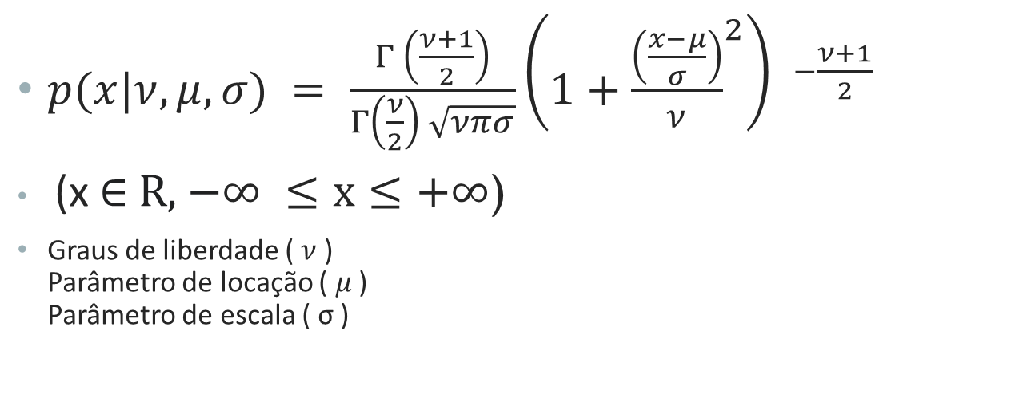
Função de densidade
$p(x|ν,μ,σ) = \frac{Γ \left(\frac{ν+1}{2}\right)}{Γ\left(\frac{ν}{2}\right) \sqrt{νπσ}}{\left(1+{\frac{\left(\frac{x−μ}{σ}\right)}{ν}}^{2}\right) }^{−\frac{ν+1}{2}}$
(x ∈ R, $−∞ ≤x≤+∞$)
Graus de liberdade ($ν$) Parâmetro de locação ($μ$ ) Parâmetro de escala ( σ )

Slide 3

Espaço paramétrico e resultados importantes
Parâmetro de locação ($μ$ ) Parâmetro de escala ( σ )
$f=\left\{f_{x}\left(x | μ\right); −∞ ≤μ≤+∞\right\}$ $f=\left\{f_{x}\left(x | σ\right); 0<σ≤+∞\right\}$
$E\left[X\right]= μ$ $Var\left[X\right]=σ^{2}\left(\frac{ν}{ν−2}\right)$

Slide 4
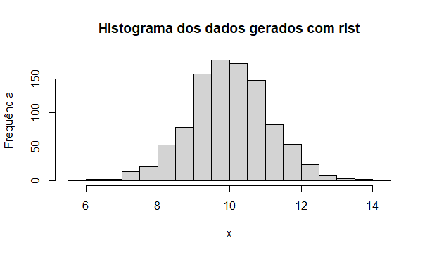
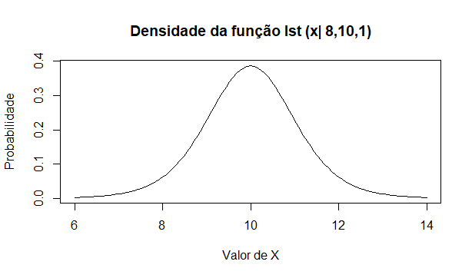
Implementação no R
Pacote “ExtraDistr” a partir da versão 1.8.7
plst(x, df, mu = 0, sigma = 1, lower.tail = TRUE, log.p = FALSE)

Slide 5
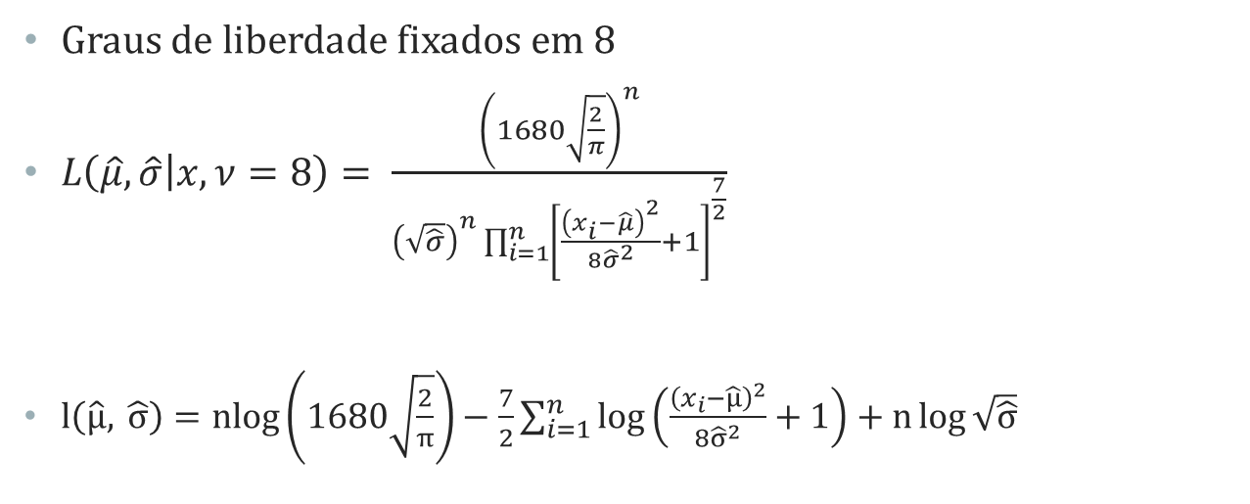
Verossimilhança
Graus de liberdade fixados em 8
$L\left(\hat{μ},\hat{σ} | x, ν=8\right)= \frac{{\left(1680\sqrt{\frac{2}{π}}\right)}^{n}}{{\left(\sqrt{\hat{σ}}\right)}^{n}\prod_{i=1}^{n}{{\left[\frac{{\left(x_{i}−\hat{μ}\right)}^{2}}{8{\hat{σ}}^{2}}+1\right]}^{\frac{7}{2}}}}$
$l\left(\hat{μ}, \hat{σ}\right)=nlog\left(1680\sqrt{\frac{2}{π}}\right)−\frac{7}{2}\sum_{i=1}^{n}{\log\left(\frac{{\left(x_{i}−\hat{μ}\right)}^{2}}{8{\hat{σ}}^{2}}+1\right)}+n\log{\sqrt{\hat{σ}}}$

Slide 6
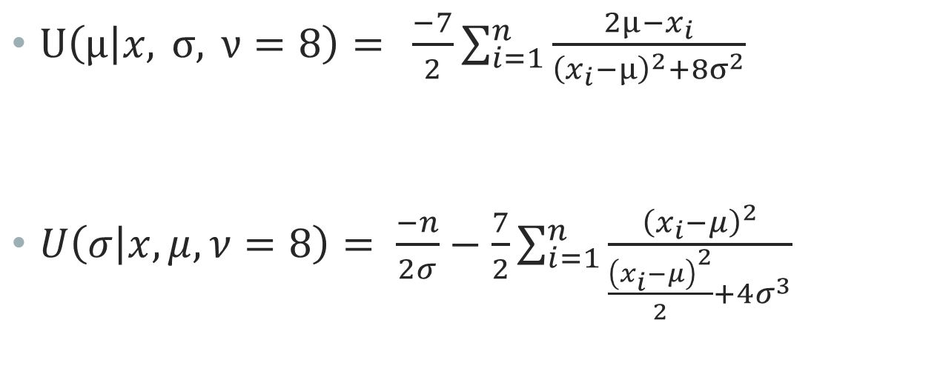
Funções Escore
$U\left(μ | x, σ, ν=8\right)= \frac{−7}{2}\sum_{i=1}^{n}{\frac{2μ−x_{i}}{{\left(x_{i}−μ\right)}^{2}+8σ^{2}}}$
$U\left(σ | x,μ,ν=8\right)= \frac{−n}{2σ}−\frac{7}{2}\sum_{i=1}^{n}{\frac{{\left(x_{i}−μ\right)}^{2}}{\frac{{\left(x_{i}−μ\right)}^{2}}{2}+4σ^{3}}}$

Slide 7
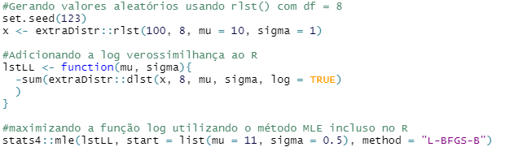
EMV

Slide 8
Referências
Jackman, S. (2009). Bayesian Analysis for the Social Sciences. Wiley. p. 507.
Bergmann, D. R., Oliveira, M. A. (2013). Modeling the Distribution of Brazilian Stock Returns via Scaled Student-t, International Research Journal of Finance and Economics. TechniumScience. p. 27
Li, R., & Nadarajah, S. (2018). A review of Student’s t distribution and its generalizations. Empirical Economics. https://doi.org/10.1007/s00181-018-1570-0
Wikipedia contributors. (2022, April 19). Student's t-distribution. In Wikipedia, The Free Encyclopedia. Retrieved 19:38, May 1, 2022, from https://en.wikipedia.org/w/index.php?title=Student%27s_t-distribution&oldid=1083494571

